Slide 1

Presentation On Mess Automation System
By
Hritik Nema (0101CA211025)
Department Of MCA
University Institute Of Technology,
Rajiv Gandhi Technological University

Slide 2
Problem
Solution
Working Of Software
System requirements
Technologies used
Modules
E-R Diagram
Data flow diagram
Conclusion

Slide 3
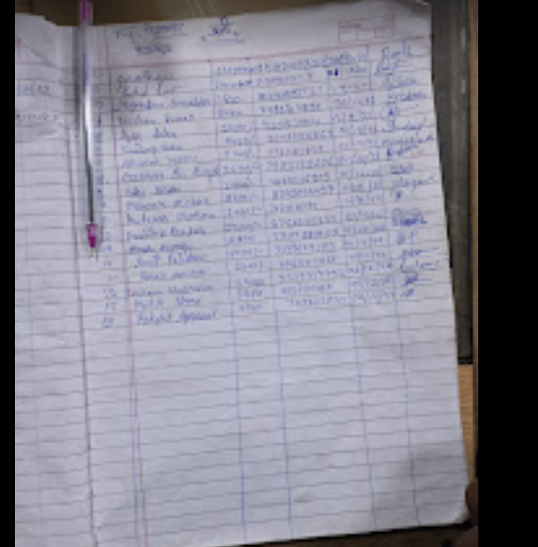
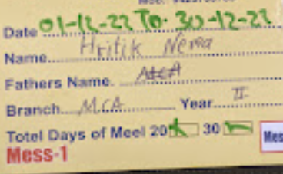
Problem

Slide 4
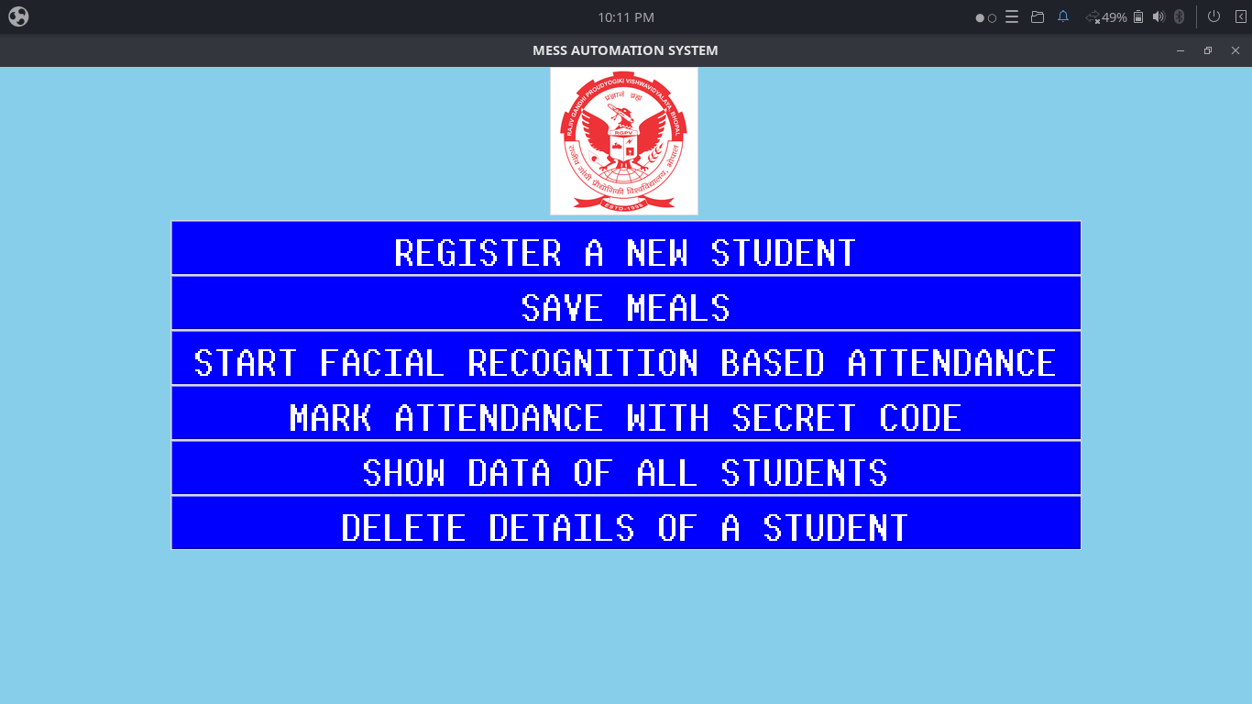
Solution

Slide 5
Working of software

Slide 6
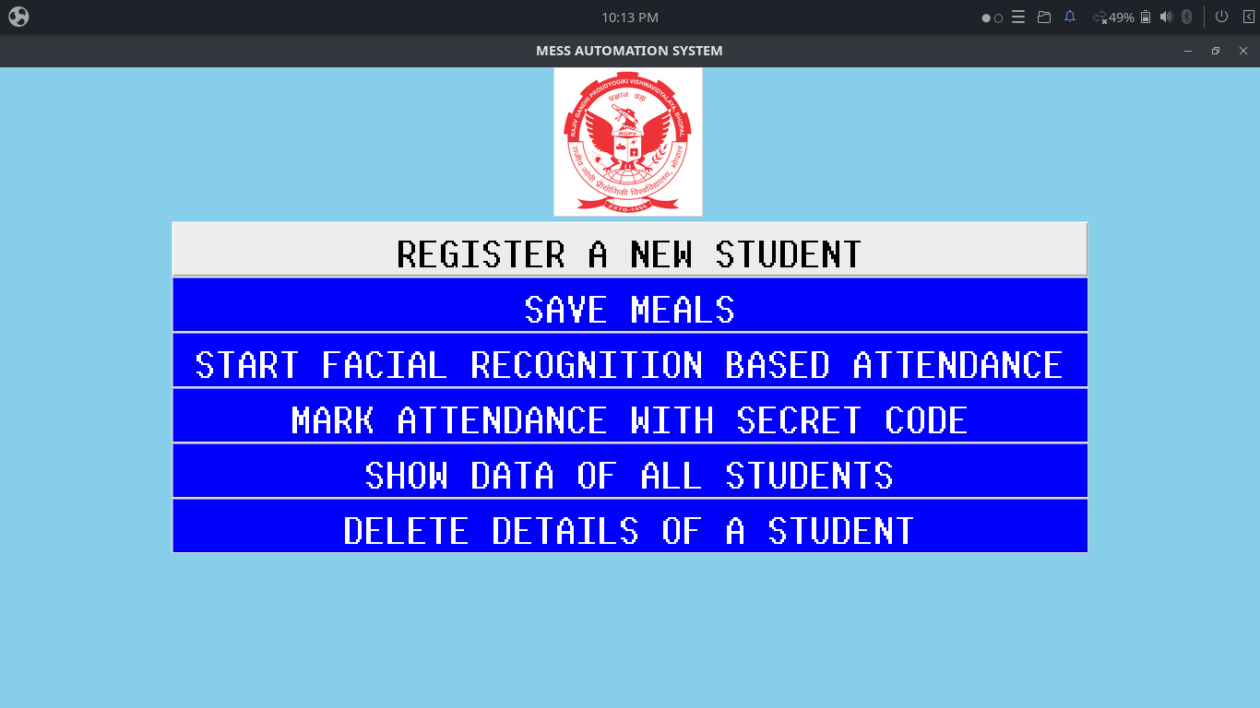

Slide 7
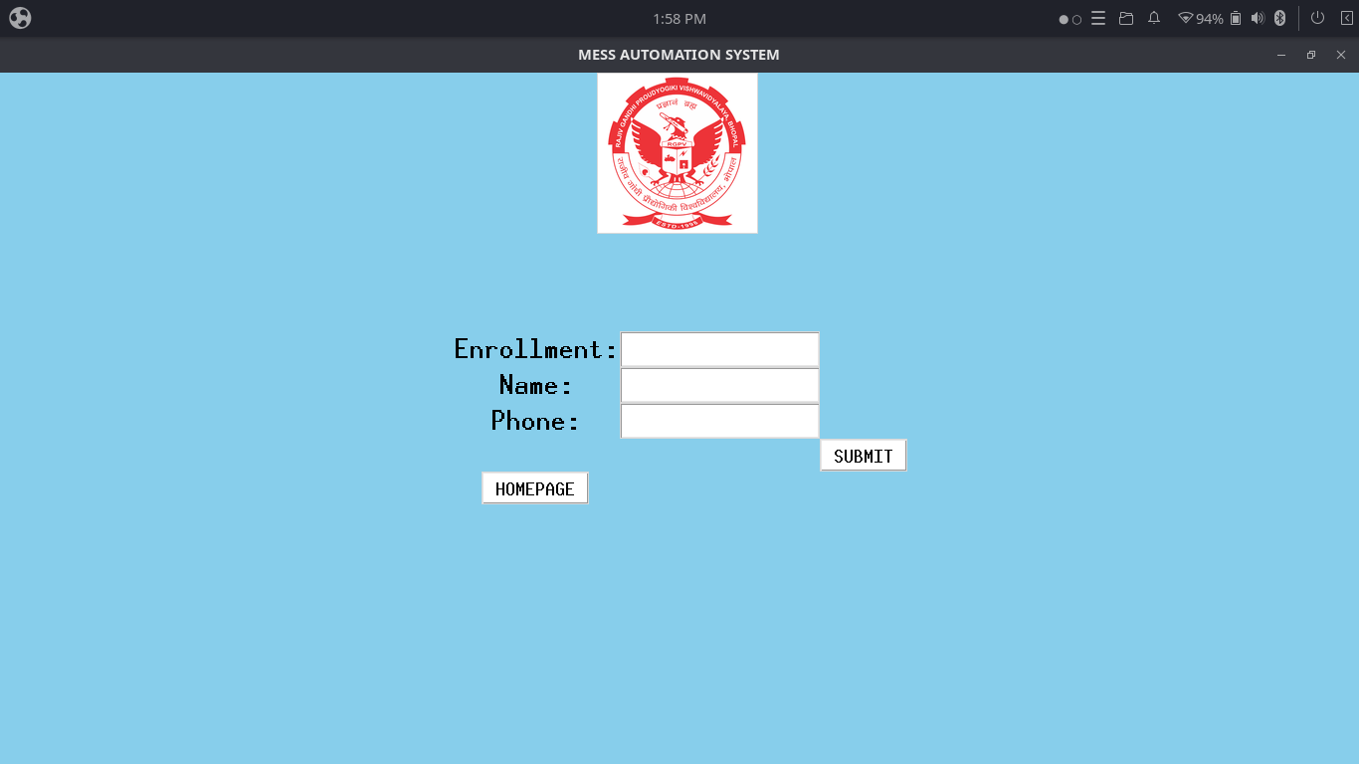

Slide 8
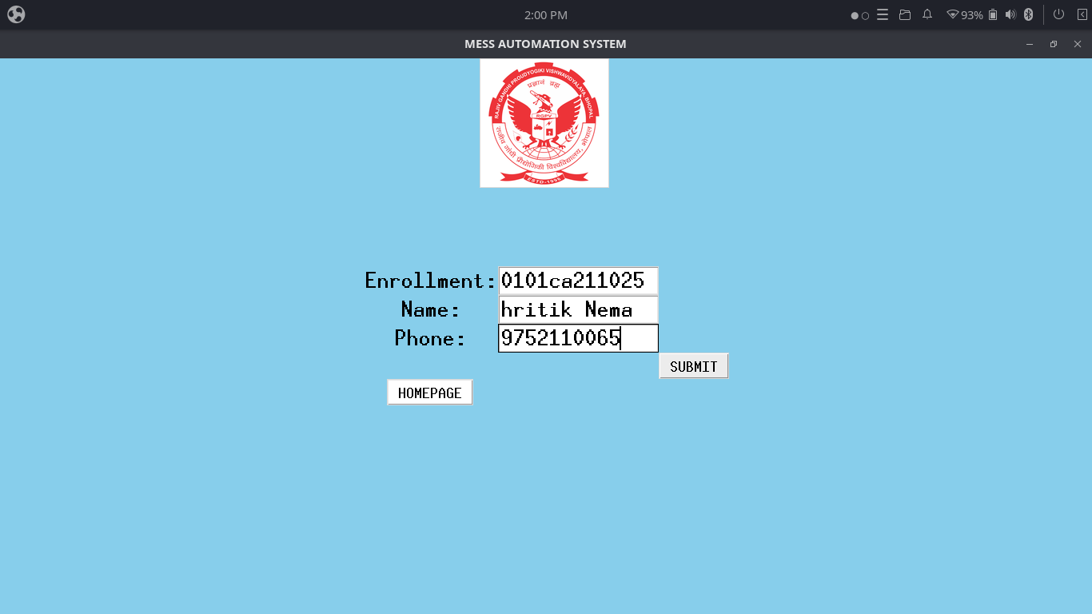

Slide 9
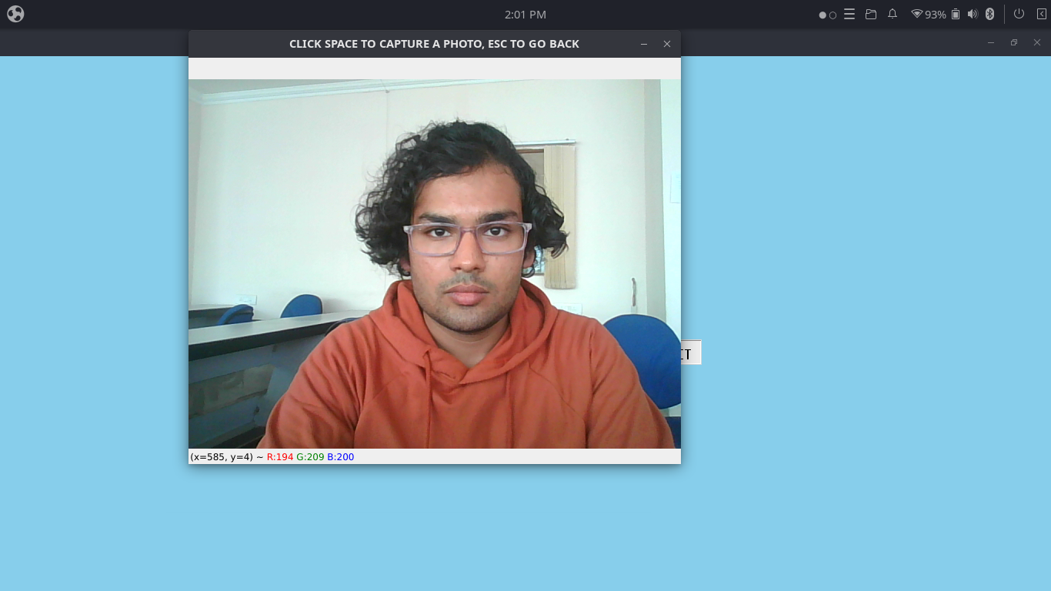

Slide 10
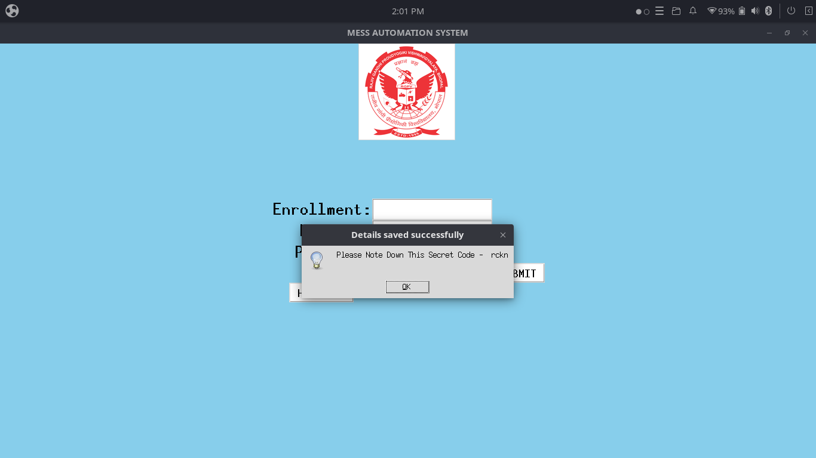

Slide 11
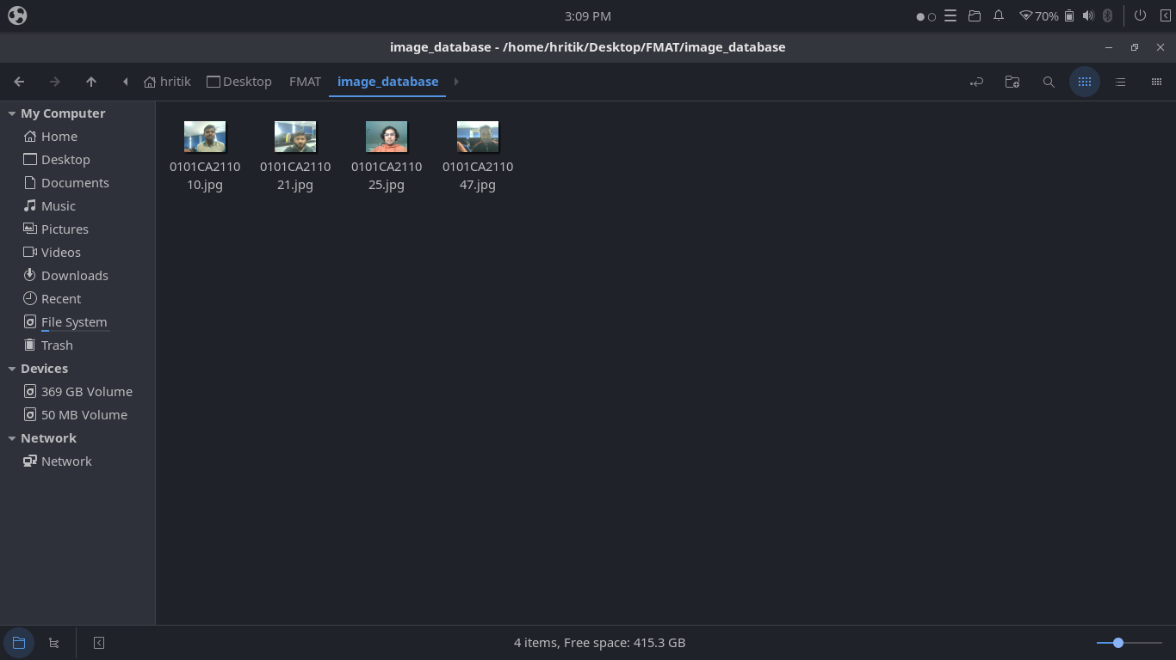

Slide 12
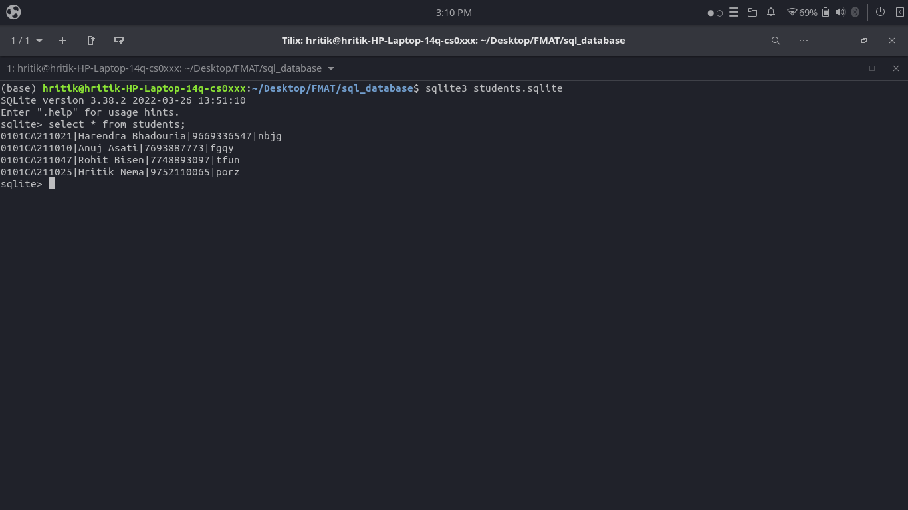

Slide 13
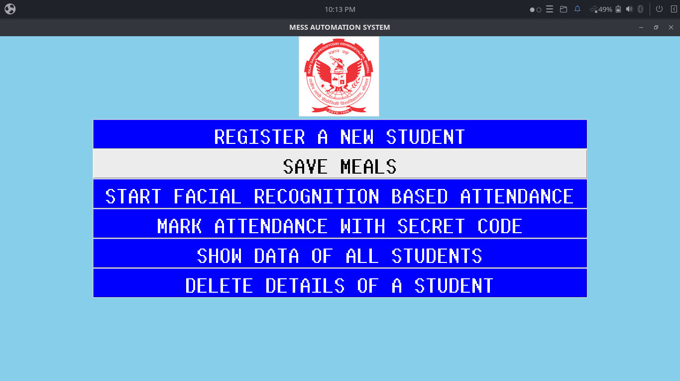

Slide 14
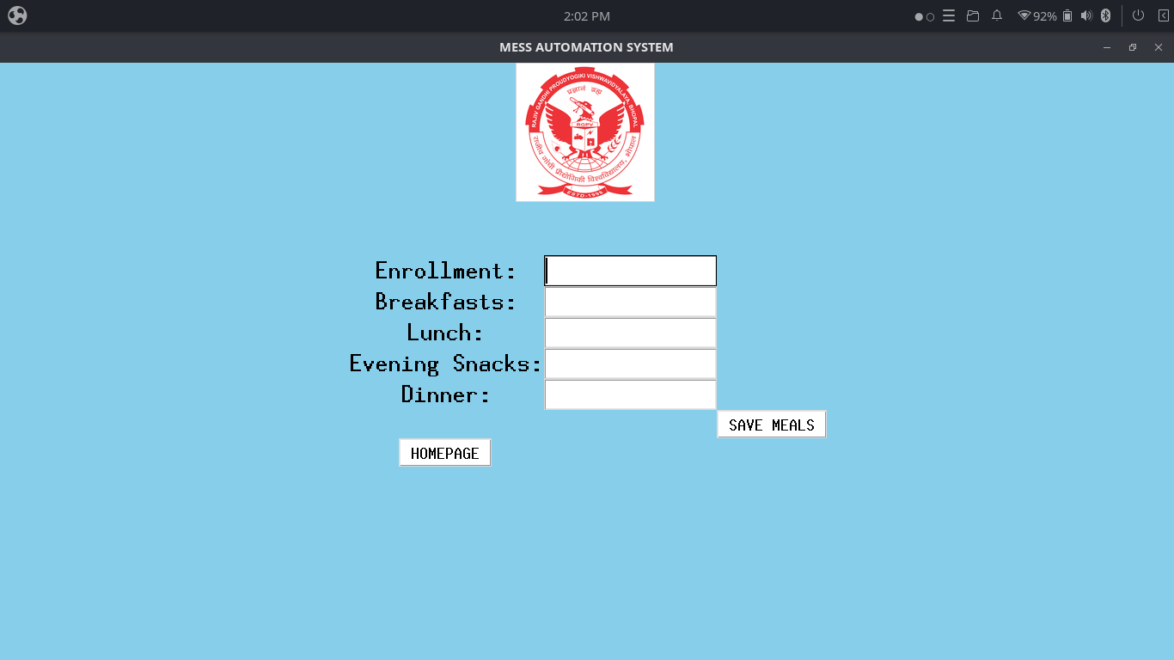

Slide 15


Slide 16
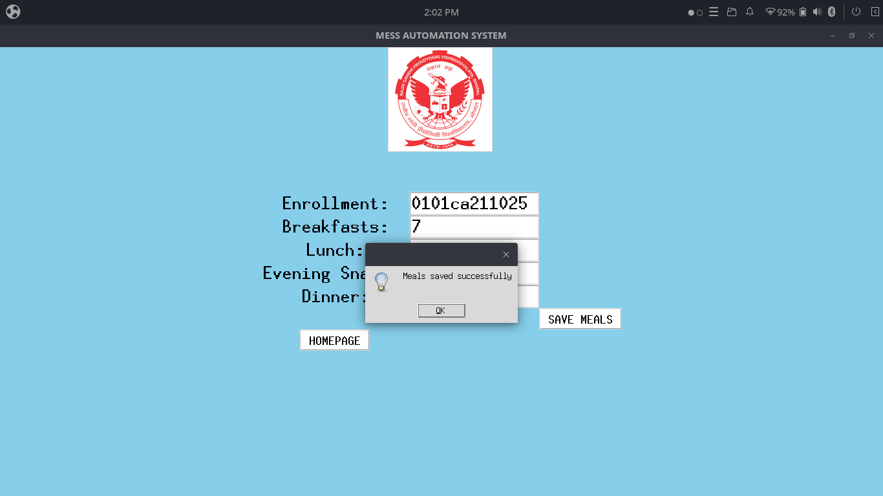

Slide 17
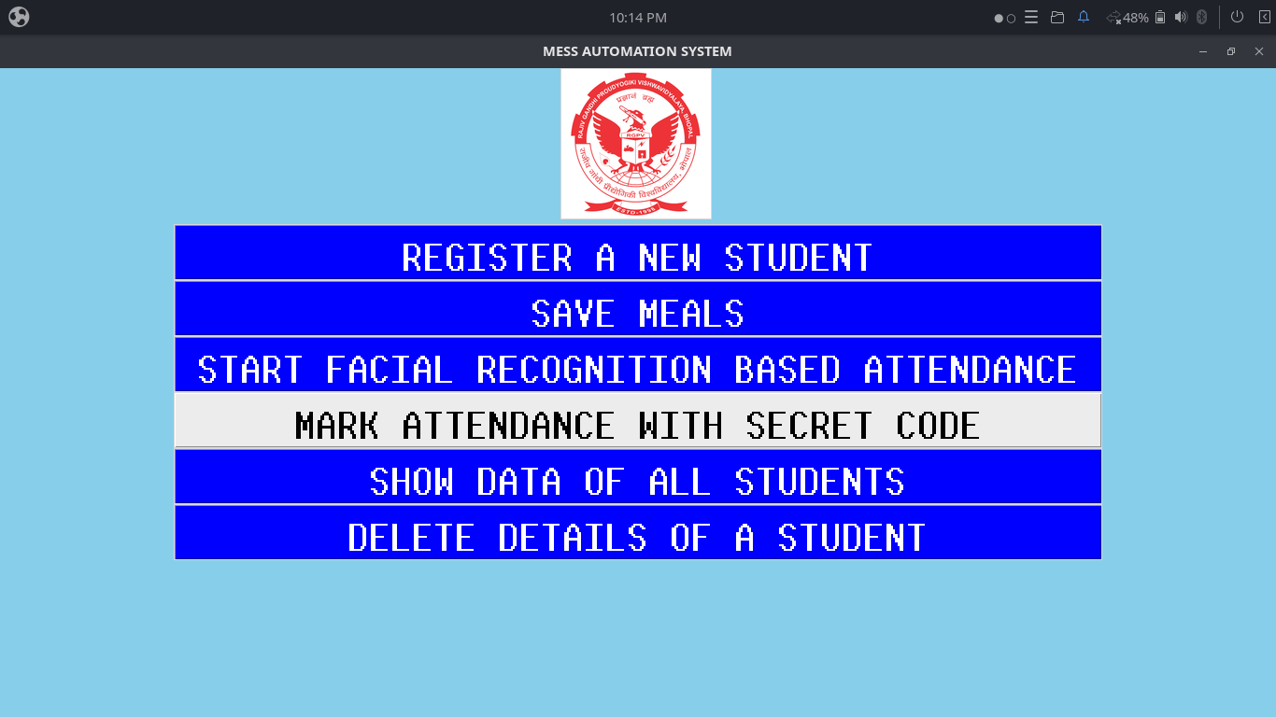

Slide 18
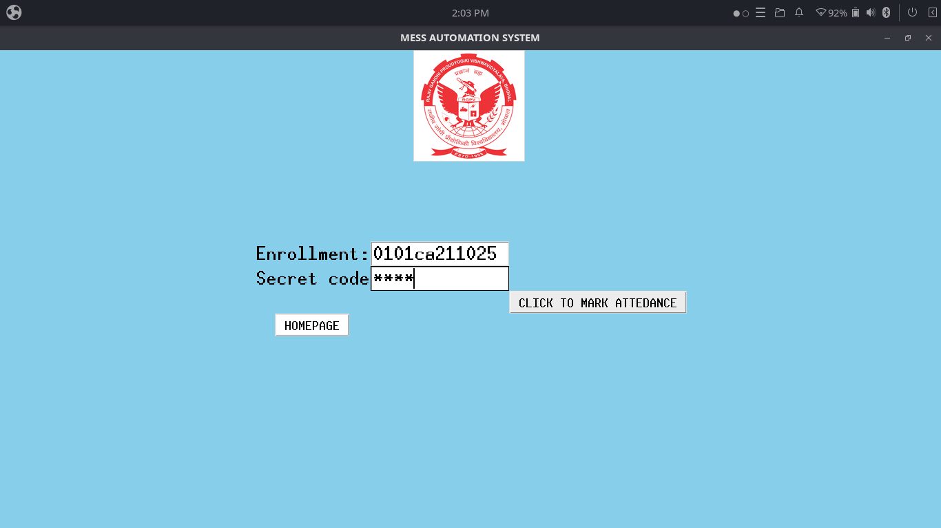

Slide 19
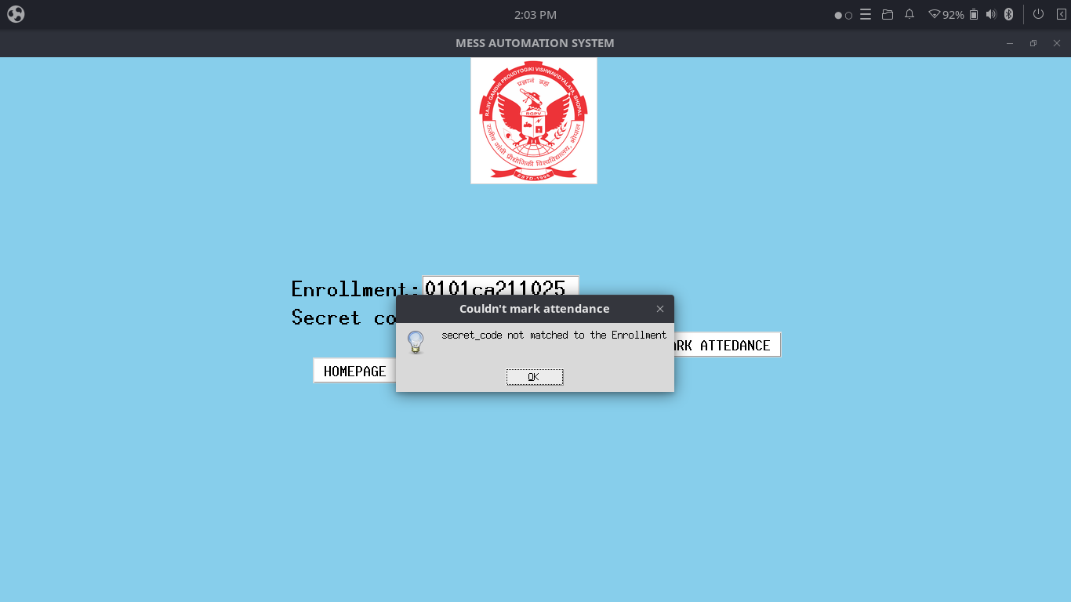

Slide 20
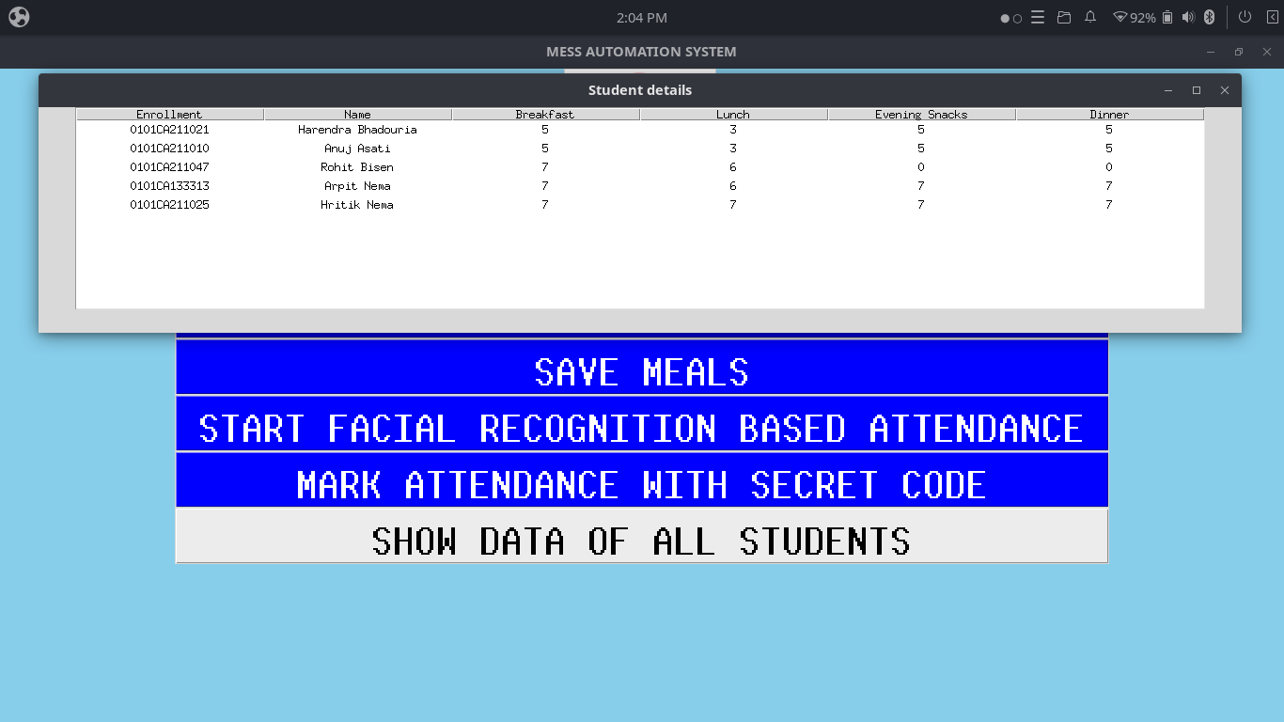

Slide 21
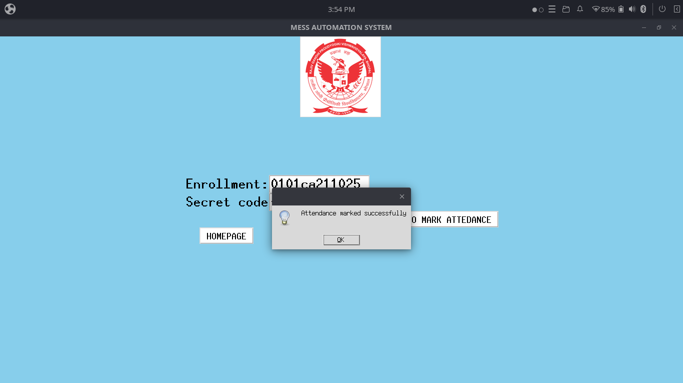

Slide 22
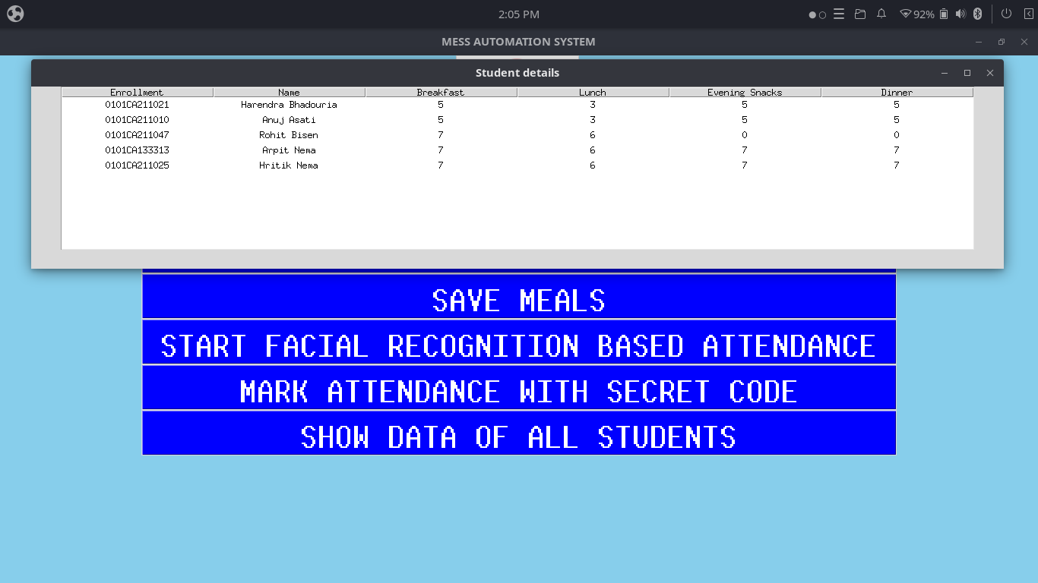

Slide 23
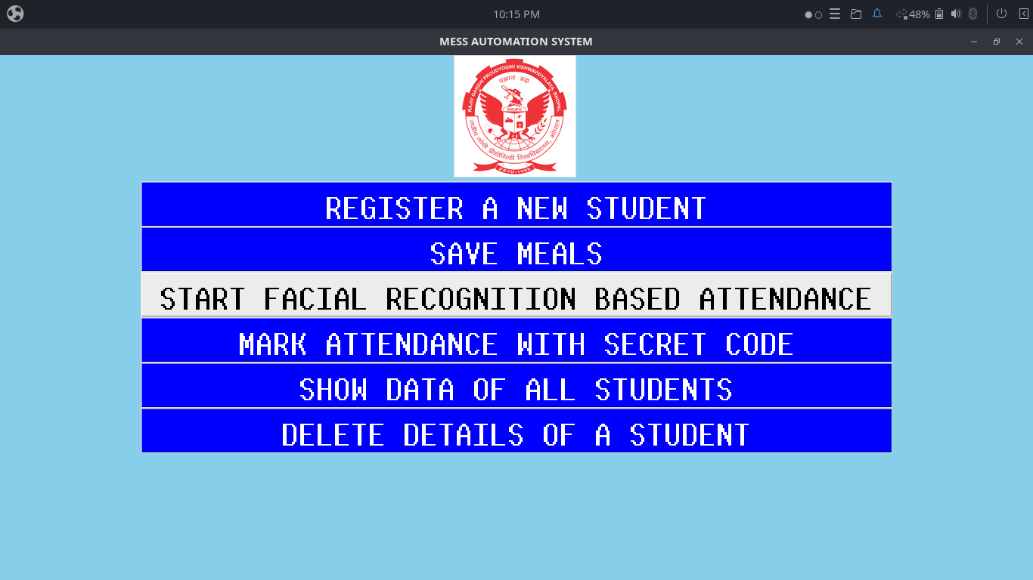

Slide 24
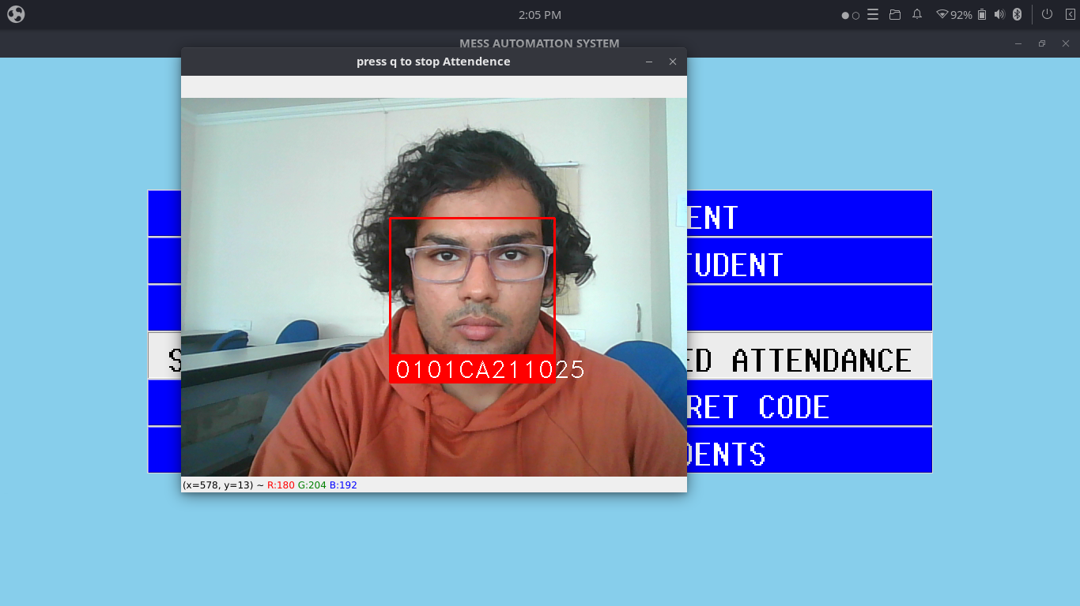

Slide 25


Slide 26
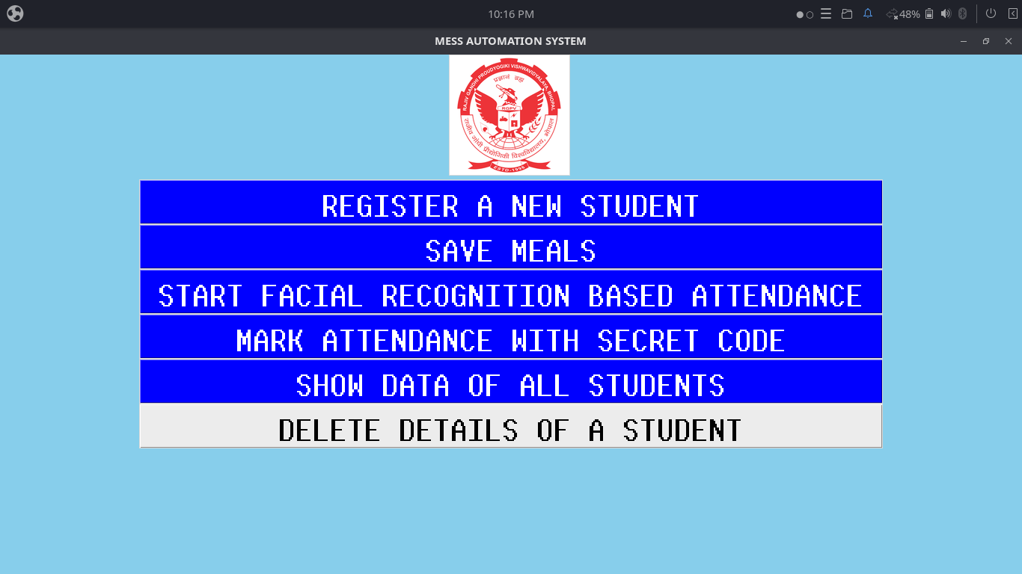

Slide 27
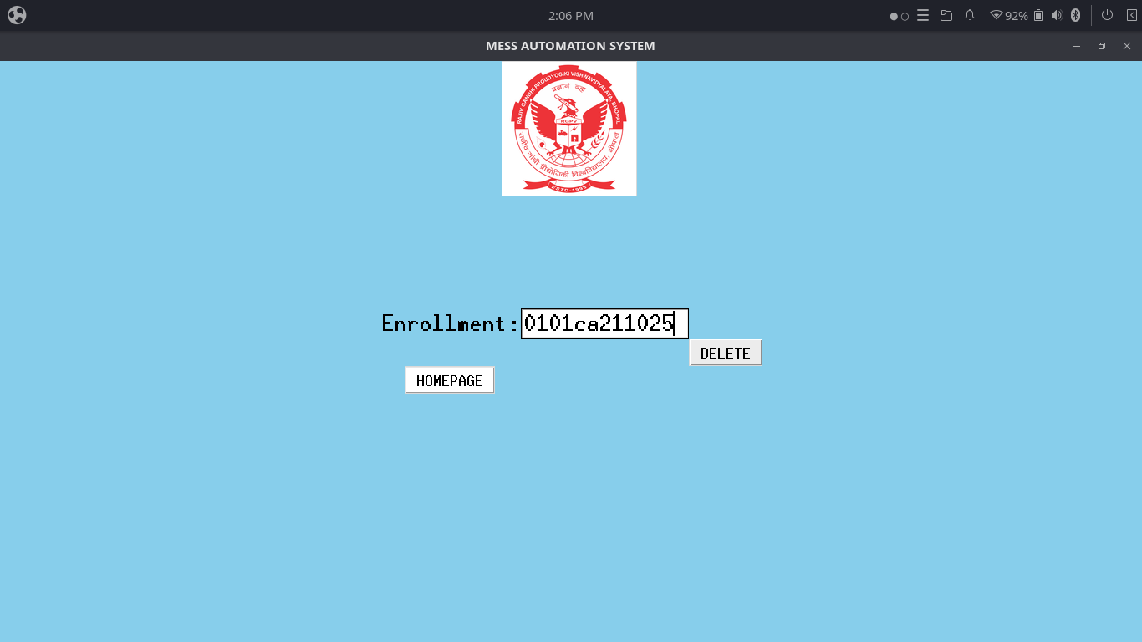

Slide 28
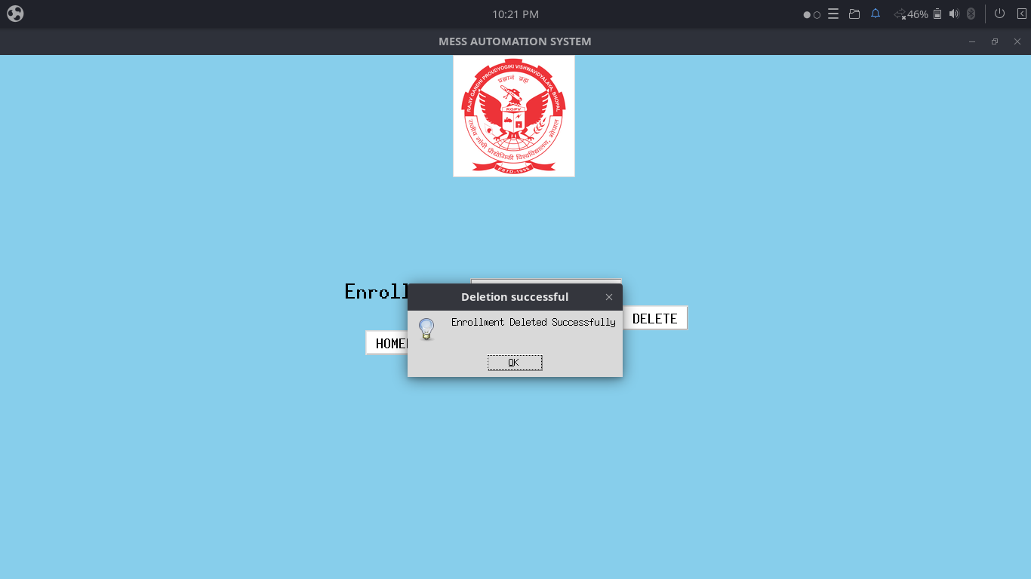

Slide 29
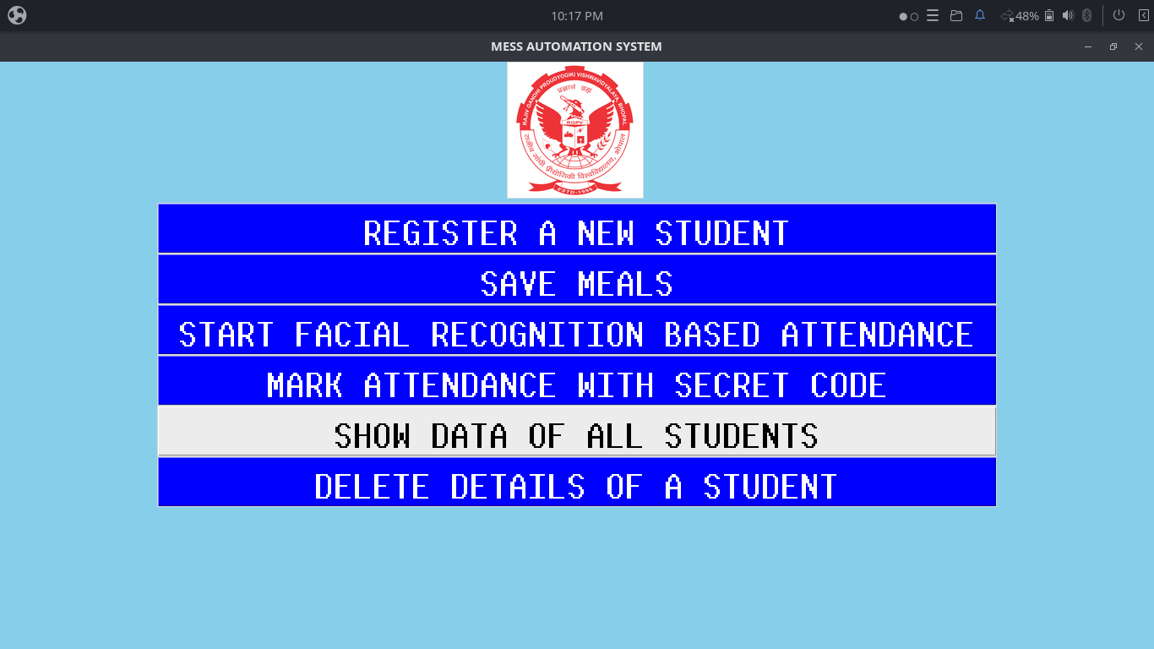

Slide 30
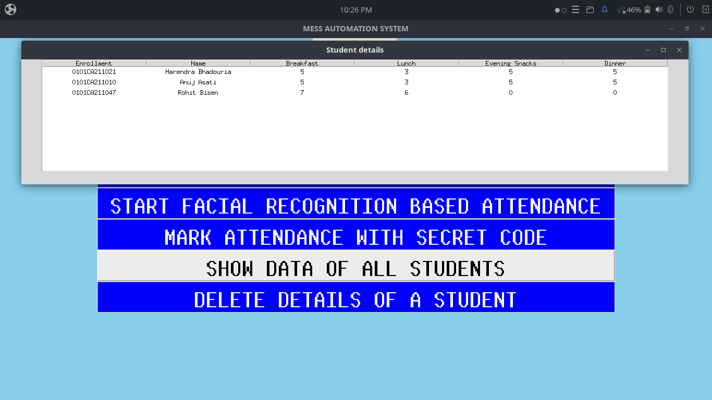

Slide 31
System requirements
Any modern cpu
At least 1 gigabyte of free ram
A working webcam
Storage space as required
Python installed, along with opencv and face_recognition
Any Modern Ide

Slide 32
Technologies used
cpu: Intel core i3 7th gen
operating system: Ubuntu budgie 22.04.1 LTS
Programming language: Python3
Ide: Spyder

Slide 33
Modules
Modules Used:
tkinter
cv2
datetime
os
face_recognition
random

Slide 34
Modules created
homepage
data_manager
recognize_face
take_picture

Slide 35
E-R Diagram
Enrollment
Meals
Enrollment
Meals
Breakfast
Pays for
Dinner
Name
Phone
Secret
code
Enrollment
Students
Enrollment
Meals
Meals
Enrollment
Evening Snack
Lunch
Pays for

Slide 36
Data flow diagram
Save
data
Delete data
User
Database
Check secret code
Mark Attendance
recognize faces
Show data

Slide 37
Conclusion
Limitations-
Dependencies
Reliability
Future Scope-
Better UI
More ways to access data

